Slide 1
Welcome!
Please, have a seat.
CWRU Quants
quants@case.edu
Notes:
CHristo

Slide 2
AGENDA
Event Recap: Poker Night
Placement Updates
Resume Workshop
Vote
Resume Reviews
Notes:
Christo

Slide 3

EVENT RECAP
Notes:
Christo

Slide 4

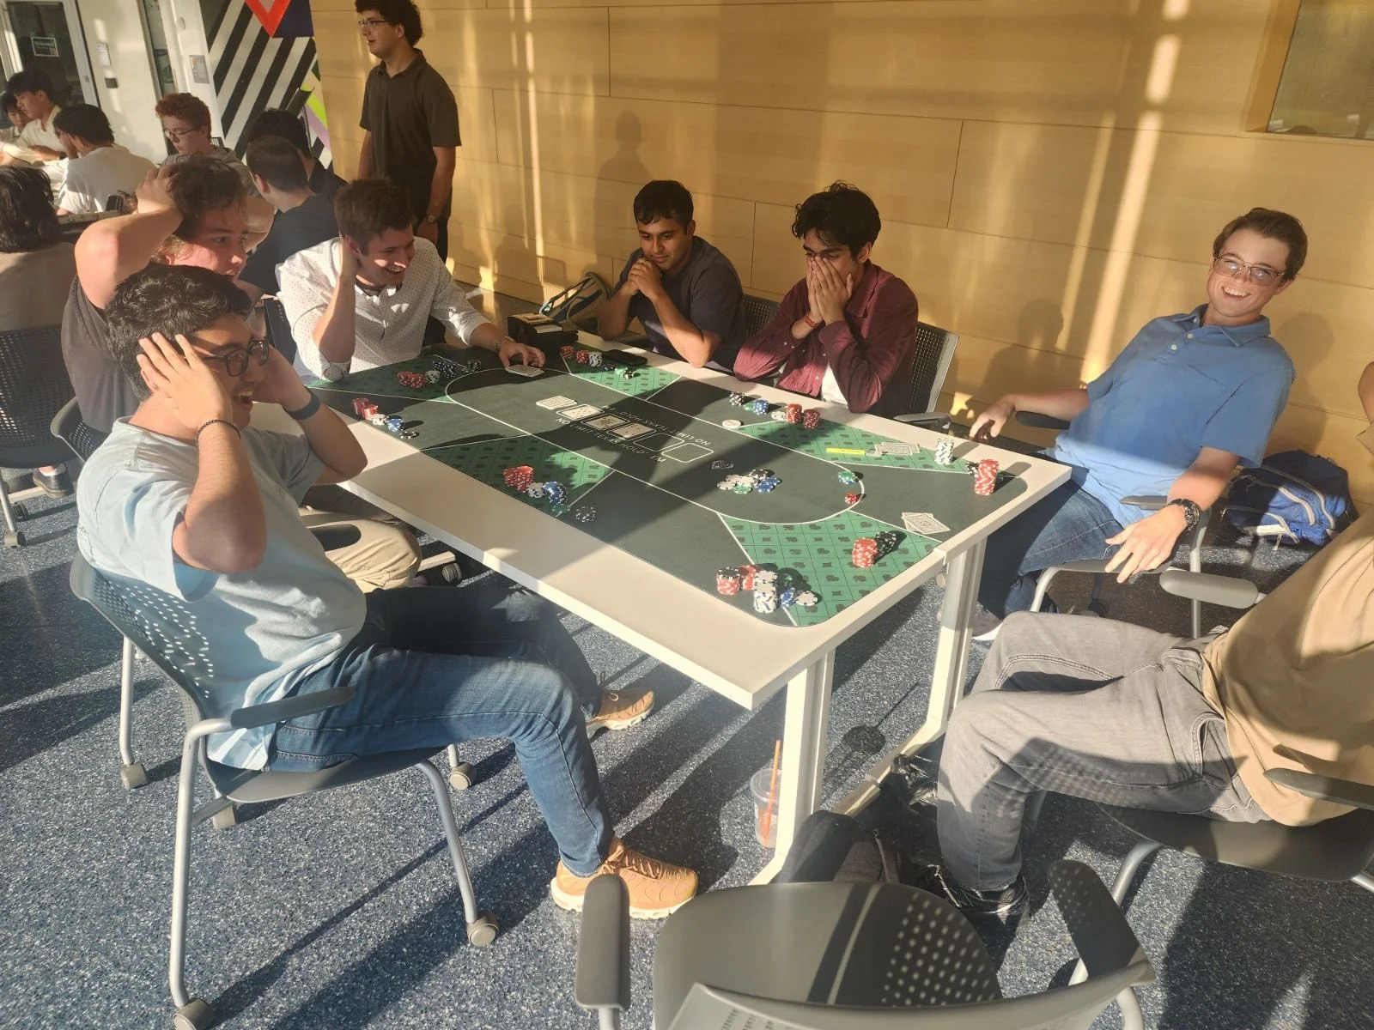

Notes:
Ethan

Slide 5
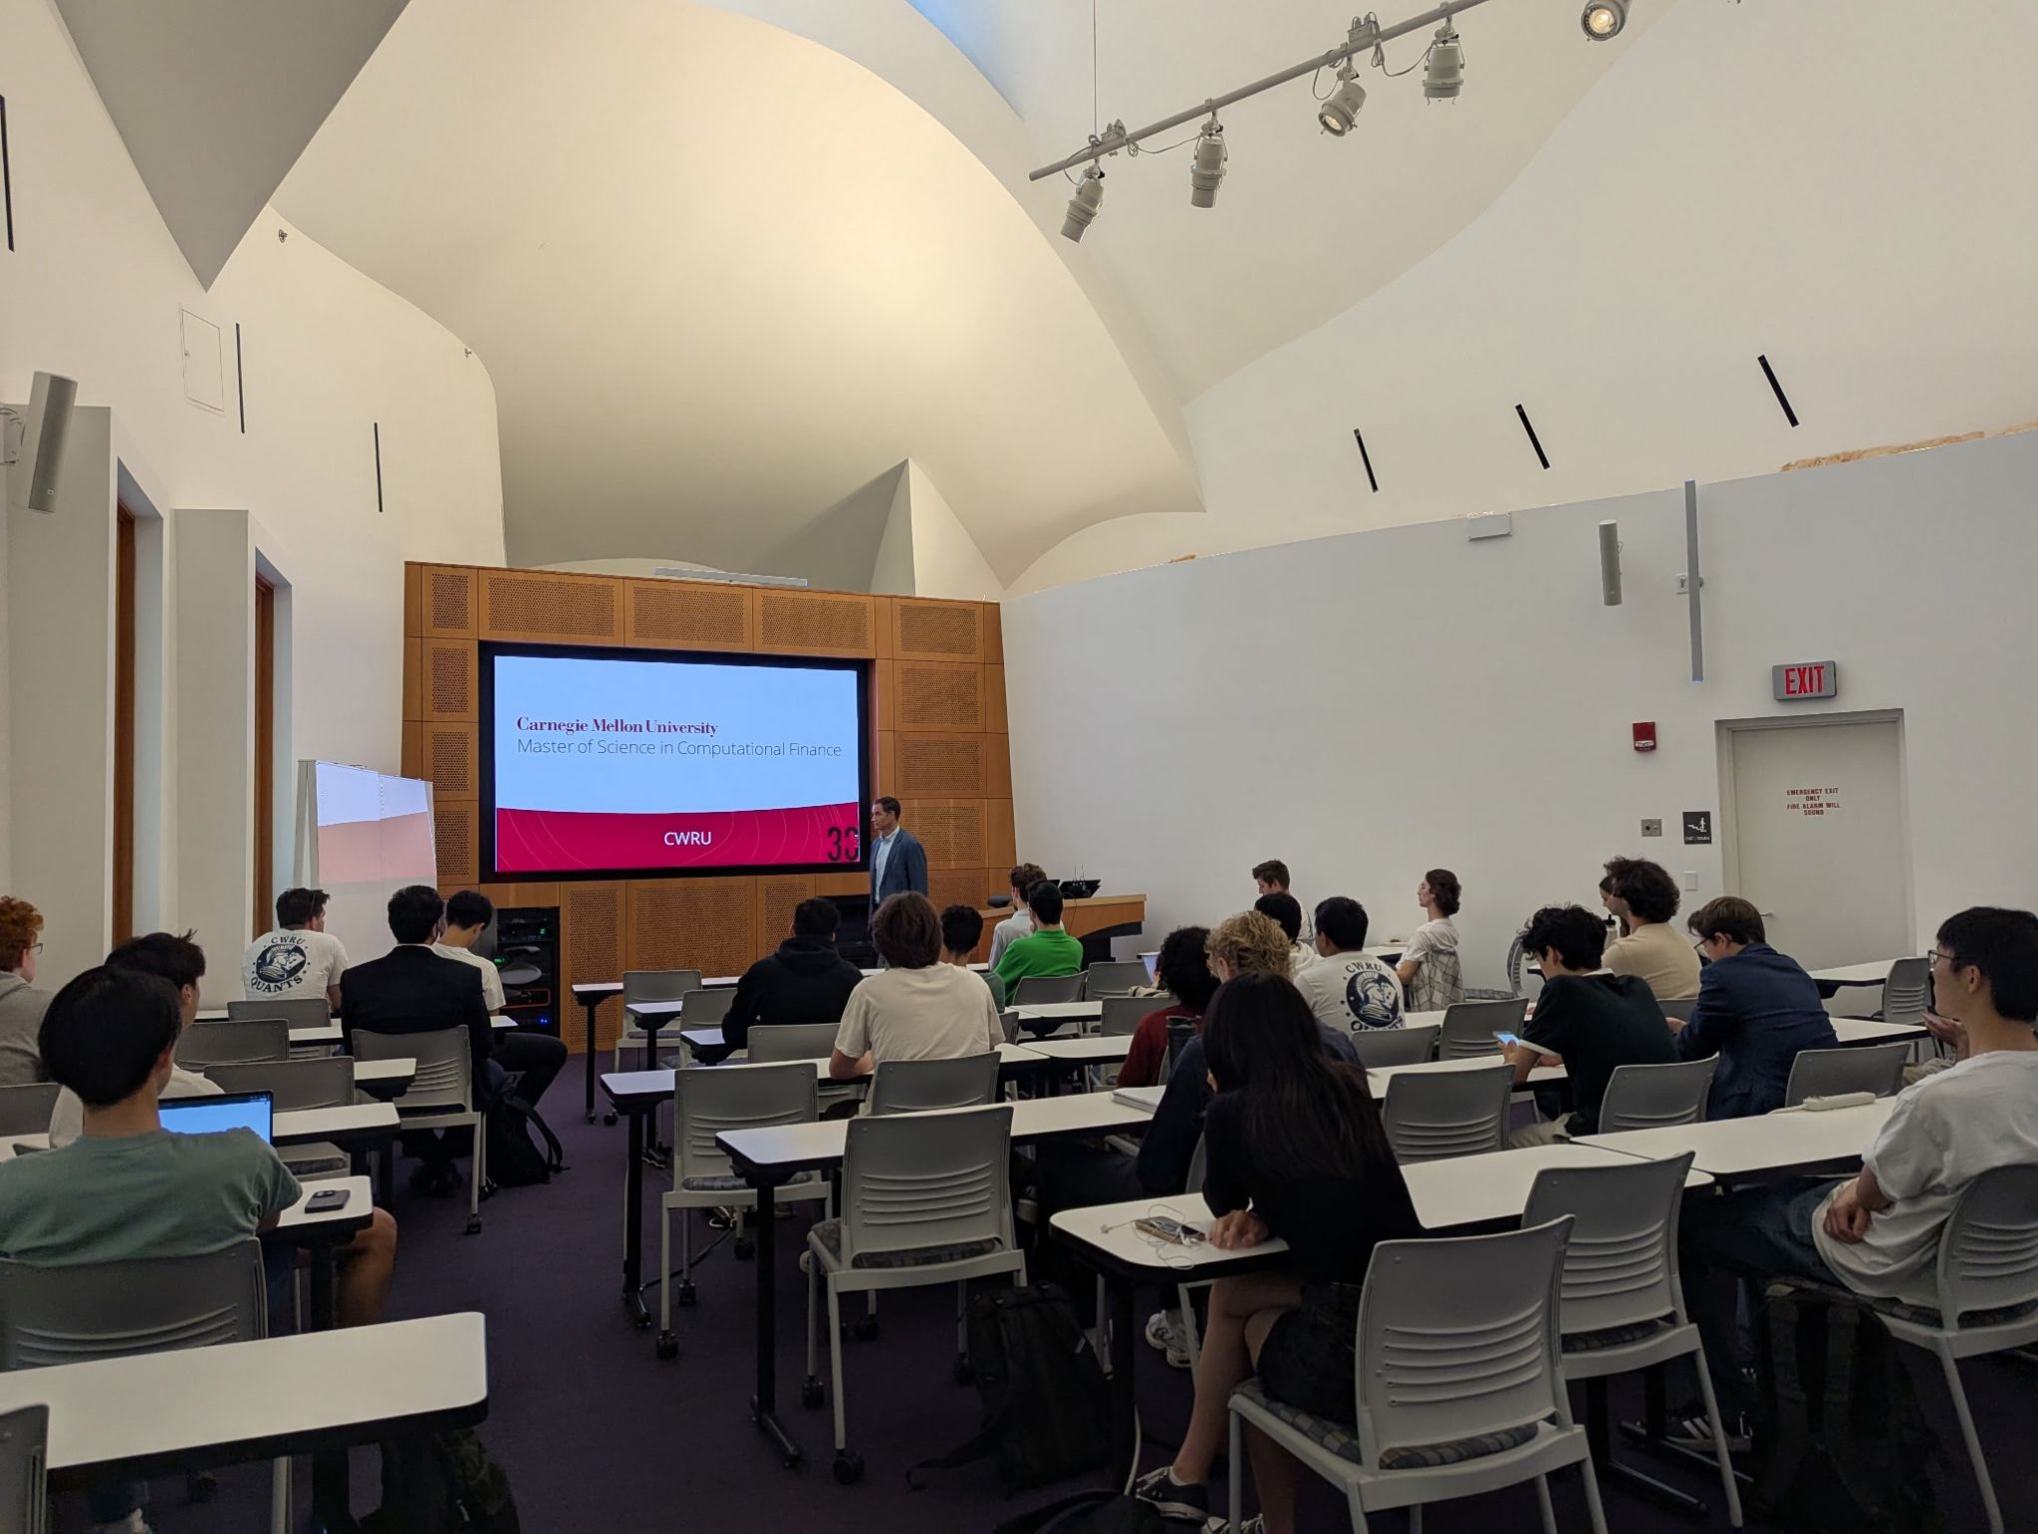
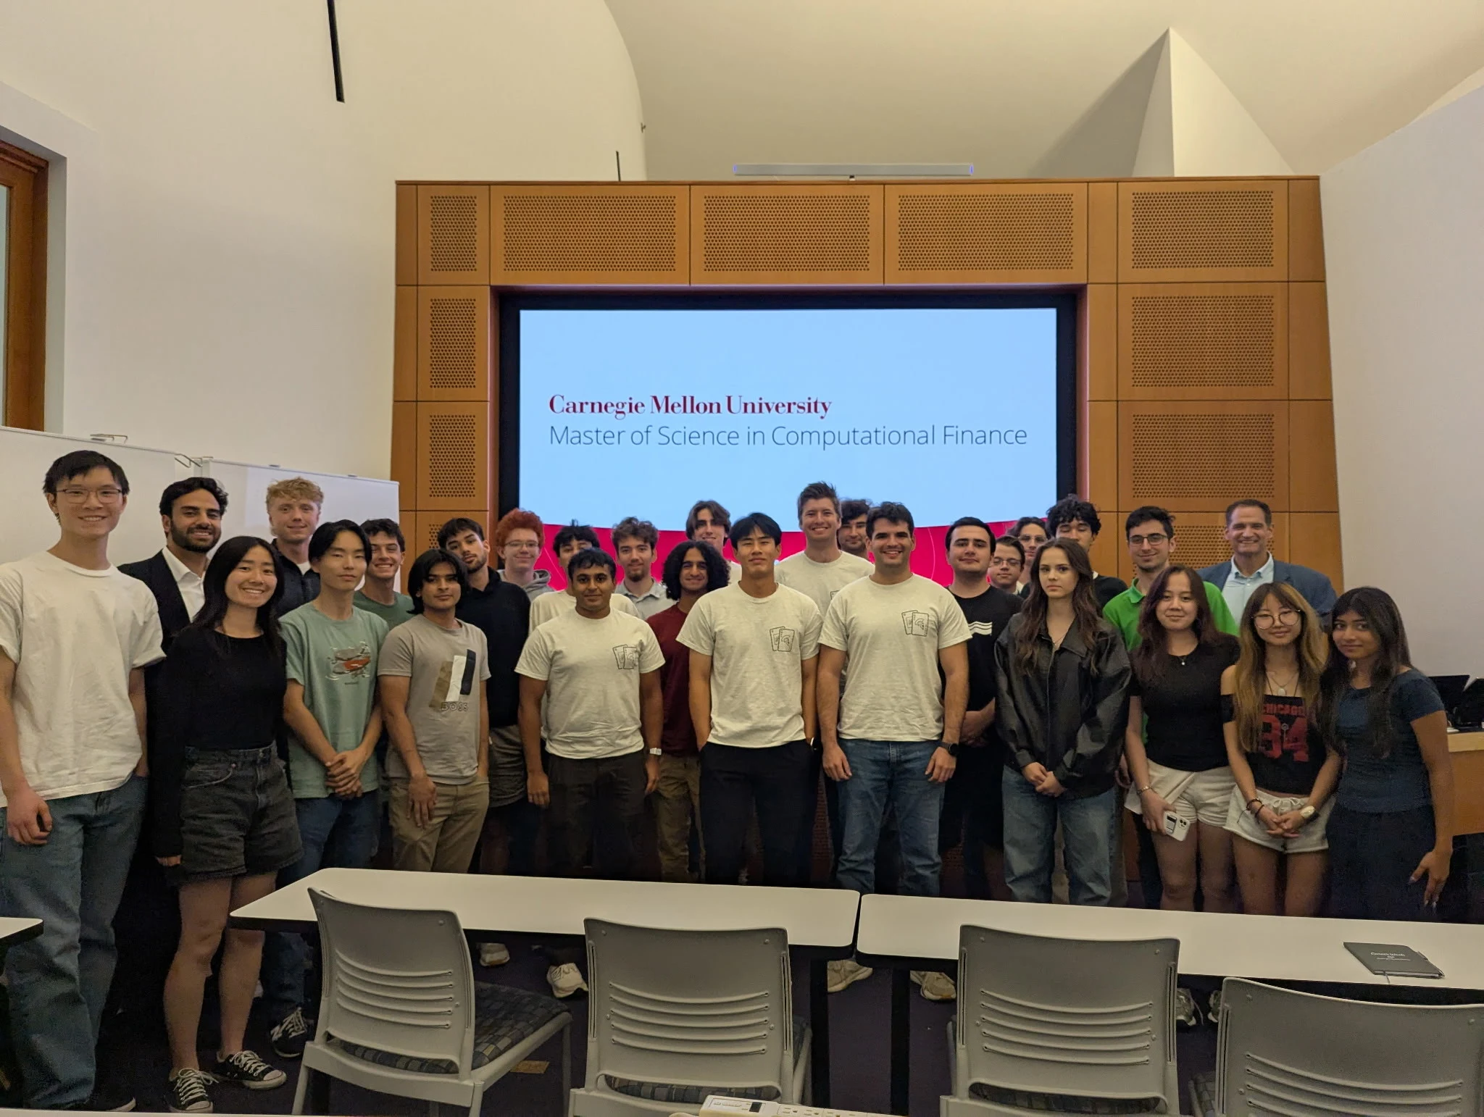
Notes:
Ray Ikome
The finance industry in the last 2-3 decades has undergone a transformation. Deregulation and technological advancements resulted in competing markets and reduced execution costs

Slide 6
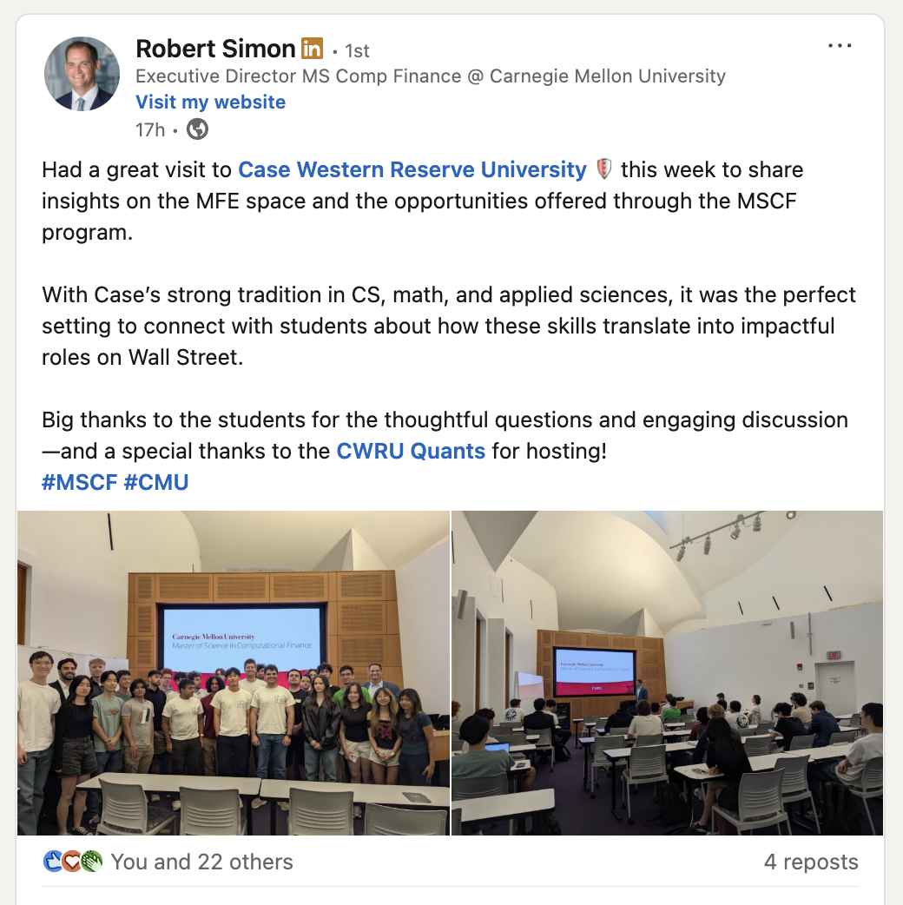
Notes:
Ethan

Slide 7
PLACEMENT UPDATES
Notes:
Christo

Slide 8


Placement Updates:
x3 Quant Interns
x1 Data Sci Intern
Notes:
Everyone

Slide 9
RESUME WORKSHOP
Notes:
Ray Ikome

Slide 10
What is a resume?
Resume - formal document summarizing a person's professional background, skills, and achievements.
Sections:
Education
Work experiences
Extracurriculars
Projects
Additional info
Notes:
Ethan

Slide 11
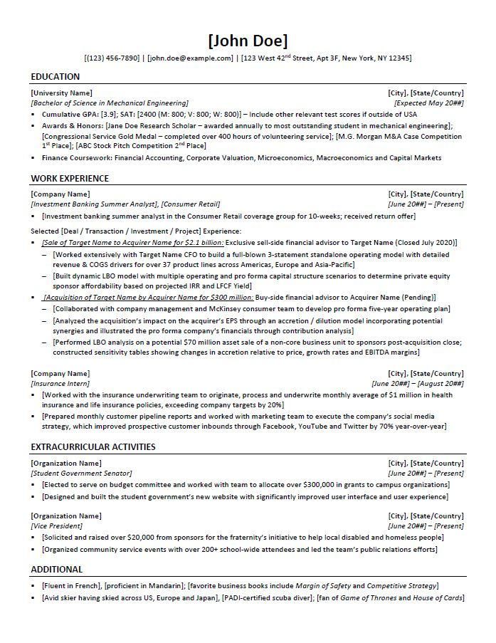
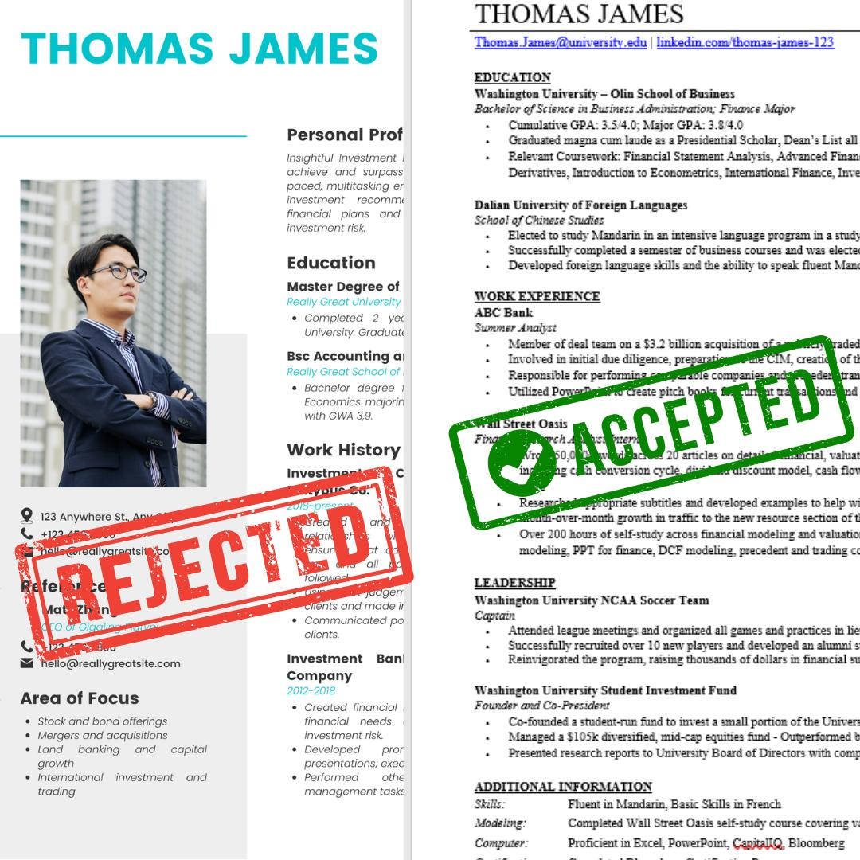
What are some qualities that you would want in an employee for your company?
Notes:
CHristo

Slide 12
Common Resume Mistakes
Lying
Nonstandard formats (colors, pictures, over 1 page)
Consistency (bullets, dashes, periods, fonts, font size)
Generic/non impactful bullets
Header (full address, personal email)
Having 1 resume for multiple industries
Notes:
Ethan

Slide 13
How do you show impact?
Context (Describe the situation)
Action (Detail specific steps)
Result (Explain the outcome and impact)
ex:
Created Access database for over 200 clients to achieve a more customized sales approach
Improved efficiency by x% by using {tools}
Notes:
Ethan

Slide 14
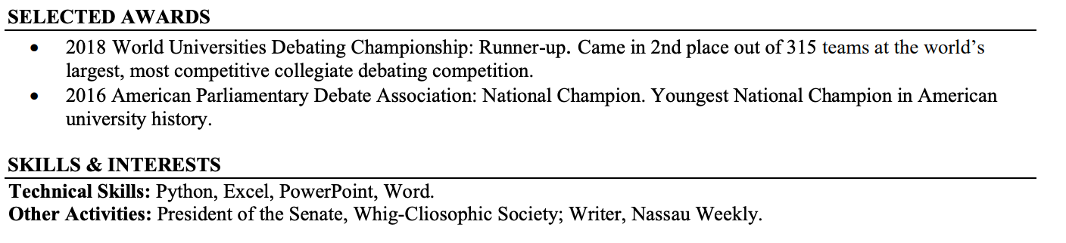
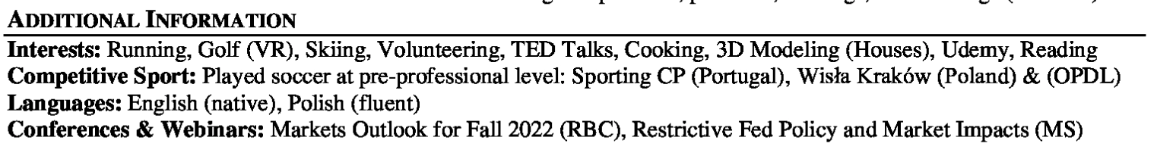
And most importantly…
include information that helps you stand out
awards, languages, certifications, non professional interests
Notes:
Ray Ikome
The finance industry in the last 2-3 decades has undergone a transformation. Deregulation and technological advancements resulted in competing markets and reduced execution costs

Slide 15
General Tips
Do not add tools, topics, subjects that you do not know, or cannot explain.
Show (quantitatively), don’t just tell
If it looks hard to read, it’s probably hard to read
Notes:
Ray Ikome
The finance industry in the last 2-3 decades has undergone a transformation. Deregulation and technological advancements resulted in competing markets and reduced execution costs

Slide 16
VOTE FOR
UPCOMING EVENTS
Notes:
Christo

Slide 17
What lecture would you like to see next week? (9/26)
Investments
Options 101
Greeks
Election Arbitrage
Notes:
Ethan

Slide 18



Social Links
@cwruquants
@cwruquants
@cwruquants
Notes:
CHristo

Slide 19
QUESTIONS
AND ANSWERS
Contact us!
Email: quants@case.edu
Instagram: @cwruquants
Notes:
Sid

